Slide 1
DATAVIZ 300 Week 6: Case Studies + Data Ethics

Slide 2
Today’s Lesson: Data Visualization at Tableau National Park Service Making a Viz Personal Guest Speaker Marisa Rodgers Q&A

Slide 3
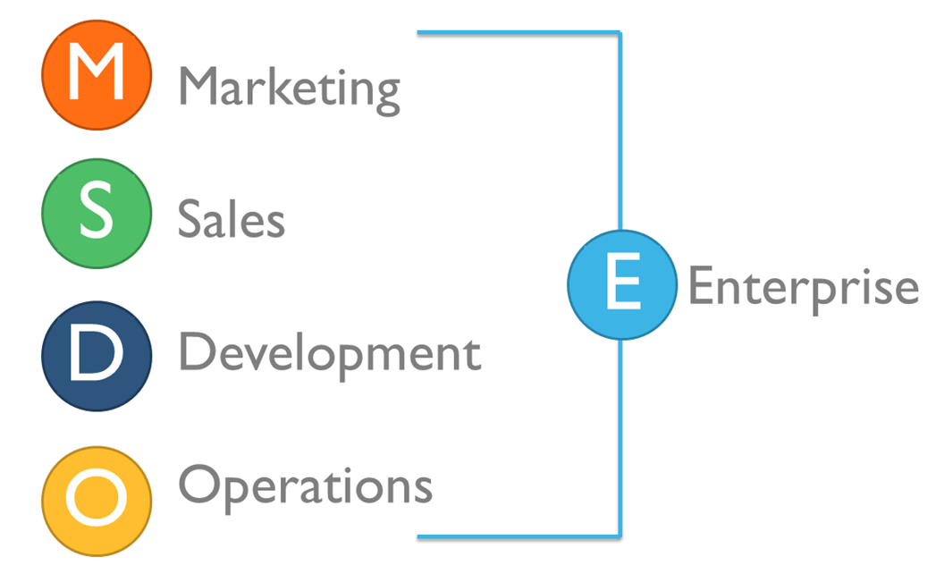

Slide 6

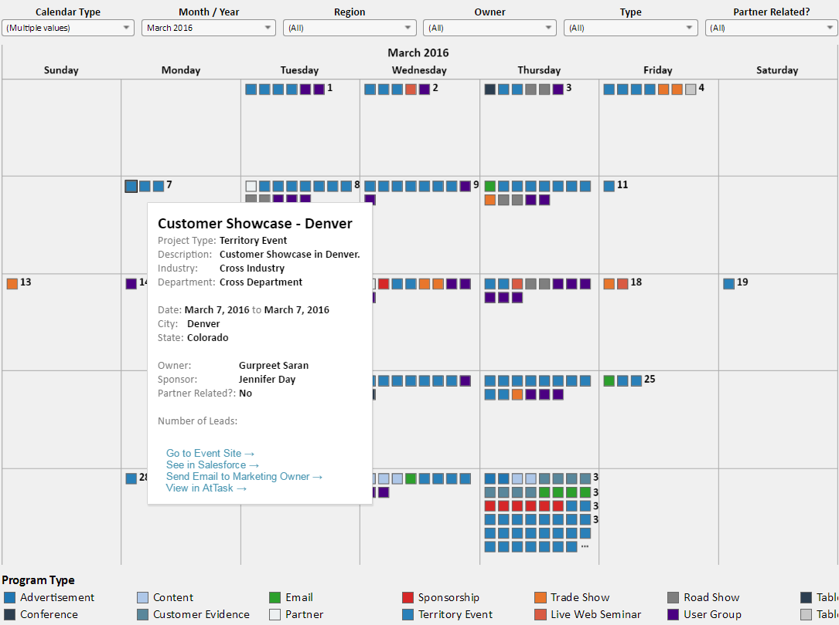
Marketing Calendar

Slide 8

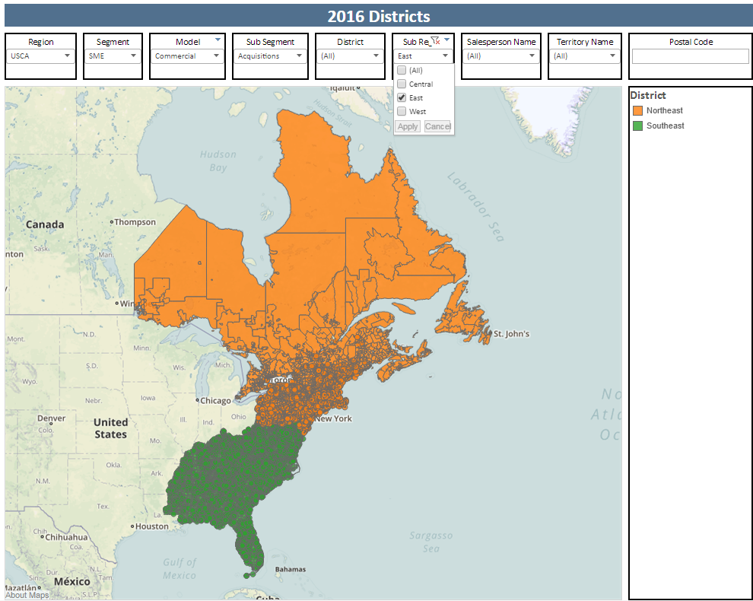
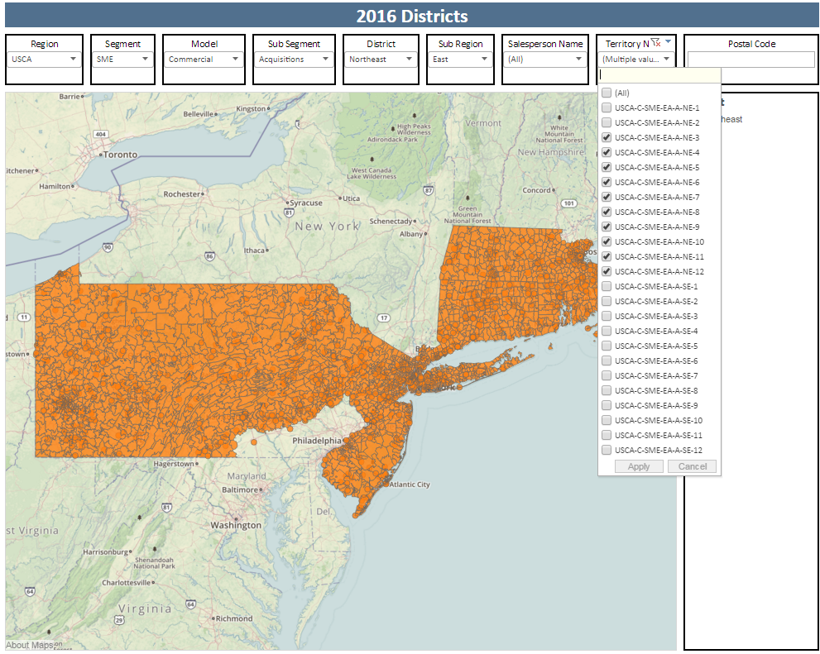
Territory Management

Slide 9
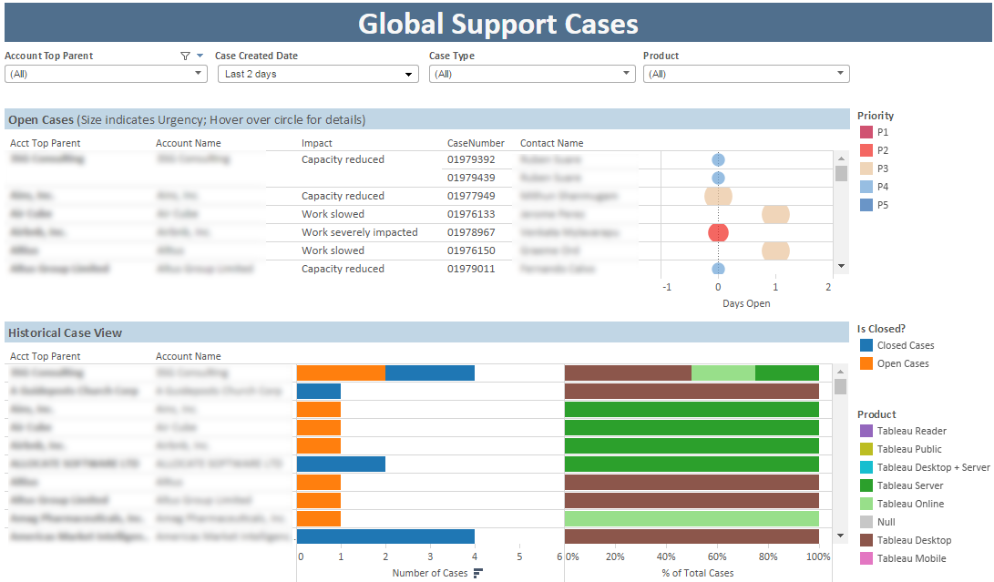
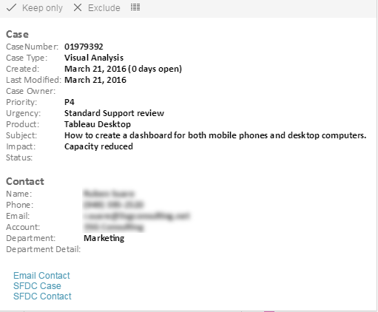
Case Management

Slide 10

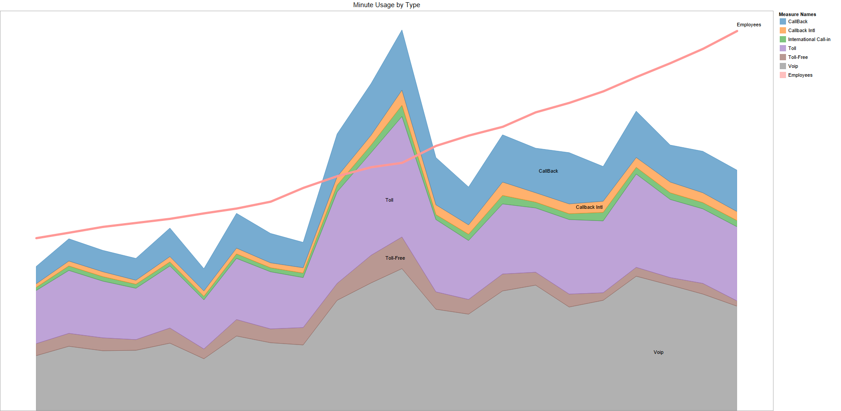
WebEx Minutes Used

Slide 11
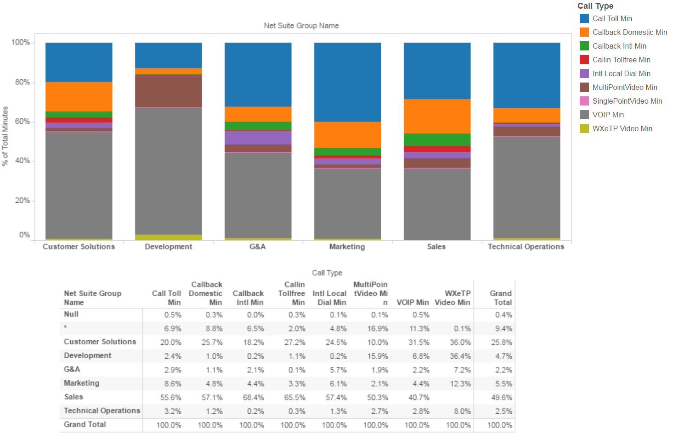
WebEx Usage
Notes:
13.5k

Slide 12
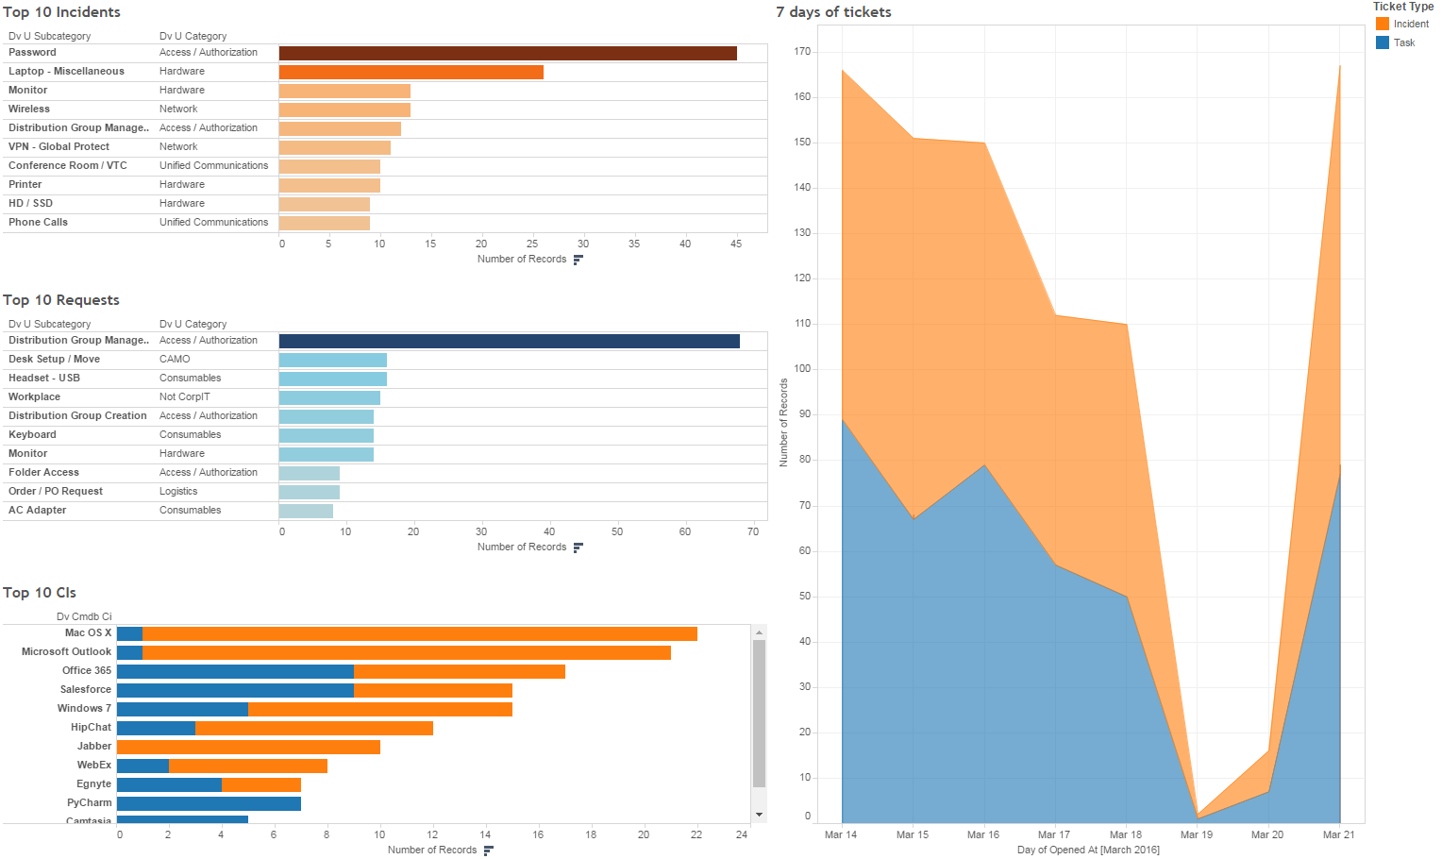
Service Now

Slide 13
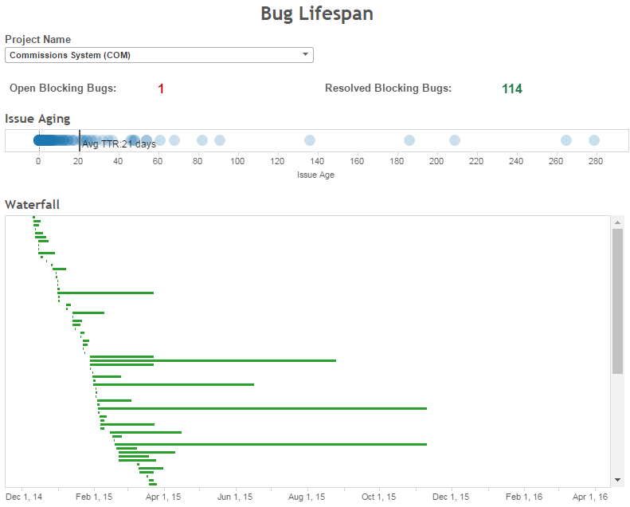
Jira Project Tracking

Slide 14
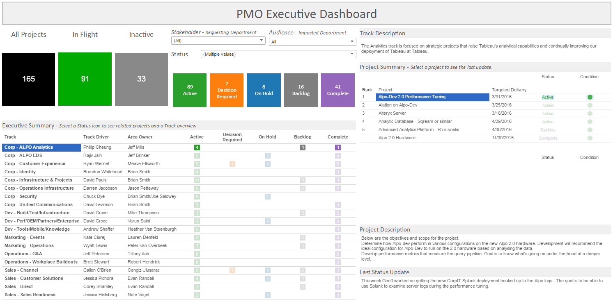
TechOps PMO

Slide 16
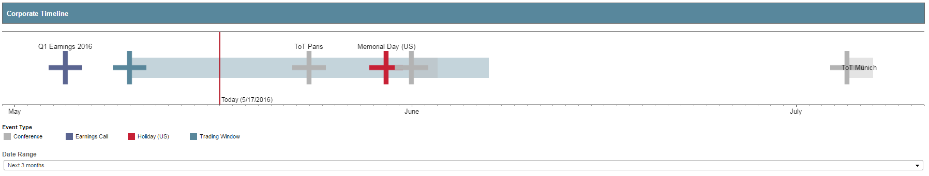

Slide 17
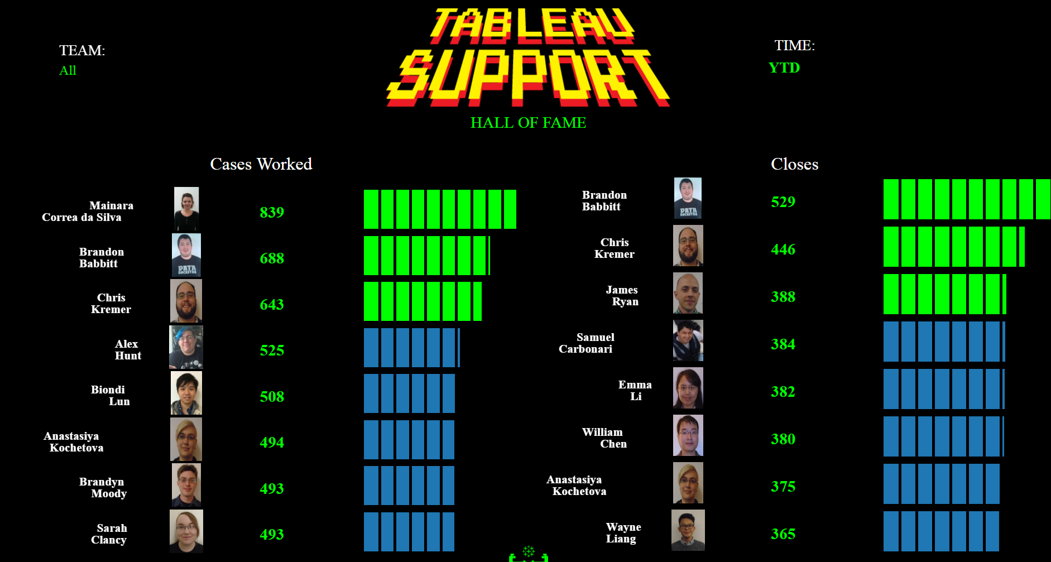

Slide 18
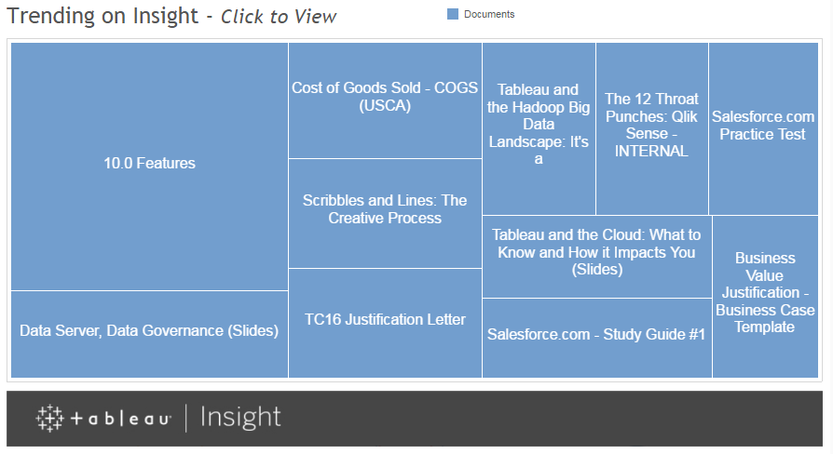

Slide 19
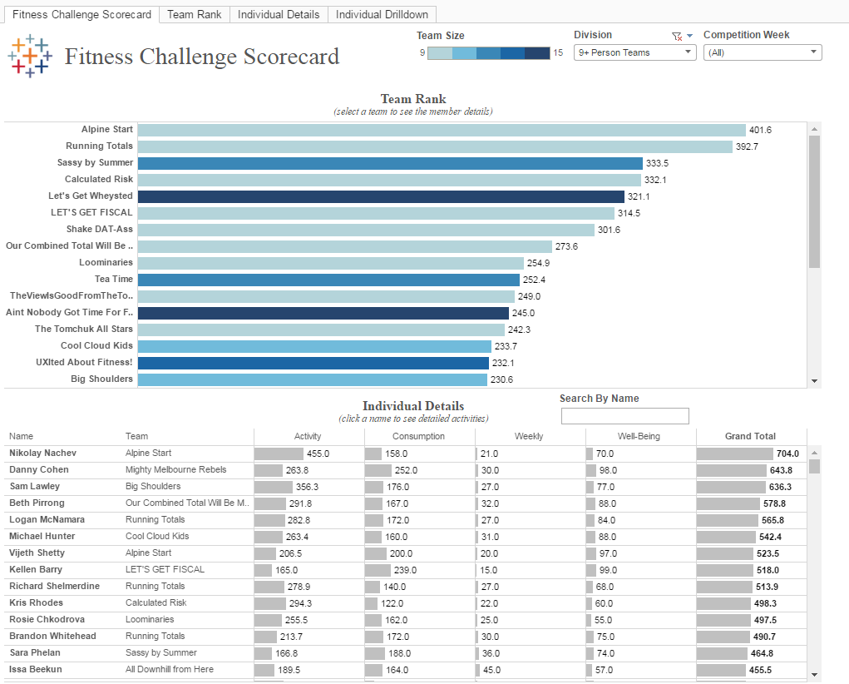

Slide 20
Today’s Lesson: Data Visualization at Tableau National Park Service Making a Viz Personal Guest Speaker Marisa Rodgers Q&A

Slide 21
Today’s Lesson: Data Visualization at Tableau National Park Service Making a Viz Personal Guest Speaker Marisa Rodgers Q&A

Slide 22
Today’s Lesson: Data Visualization at Tableau National Park Service Making a Viz Personal Guest Speaker Marisa Rodgers Q&A

Slide 23
Data Privacy & Ethics
Marisa Rogers
Director, Global Sales & Marketing Privacy
Microsoft

Slide 24
Biography
University of Washington
B.A. Business Administration; concentration in Information Systems
Accenture
Specialties: Process Improvement, Telecommunications Industry
Microsoft
HR Program Manager → HR Privacy Manager → Sales & Marketing Privacy Manger

Slide 25

What is data privacy?

Slide 26
Data ethics questions
What is Privacy in a society characterized by massive data sharing?
To what extent should ethical considerations influence the development of new technologies?
Is ethics an alternative to the law or complementary to the law?

Slide 27
What’s next?
Ethics committee for digital society?
A policy on data ethics for businesses and governments?
Restoring data traceability in the big data (new ways of accountability)
Integrate an ethical dimension into the work of regulators?

Slide 29
Thank you!

